Slide 1
Course - DT228/1 and DT282/1
Subject - Computer Architecture and Technology
NEW ARCHITECTURES AND TECHNOLOGY
Semester 2, Week 11

Slide 2
Computer Architecture – Where is it Going?
The enduring model of computer systems is von Neumann architecture. Could this change?
What is the development focus on microprocessors?
What is the development focus on motherboards?

Slide 3
Computer Architecture – Where is it Going? (2)
Developing CPU Architecture
Is processor innovation dealing with:
RAM increase?
Power consumption decrease?
Multiple cores?
Processor/coprocessor (manufacturer) integration?

Slide 4
Computer Architecture – Where is it Going? (3)
Developing CPU Architecture
RAM increase
Power consumption decrease
Multiple cores
Processor/coprocessor (manufacturer) integration
ALL of the above (plus registers, mux and the like…)

Slide 5
RAM Increase
Random Access Memory has been increasing in standard PC and laptop specifications:
2 GB around 2002
4 GB
8 GB
16 GB now (2 x 8GB), in 2017 (Dell Inspiron 15 7000 series)

Slide 6
DDR3 and DDR4
DDR – Double Data Rate – refers to the specification for Random Access Memory, and the current ‘high end’ of DDR3 may be more efficient than the emerging DDR4.
DDR4 architecture uses 1.2 volts (1.5 DDR3), and has a transfer rate of 2000 MT (million transfer per second) – (800 MT for DDR3), but best suited to multi-servers.

Slide 7
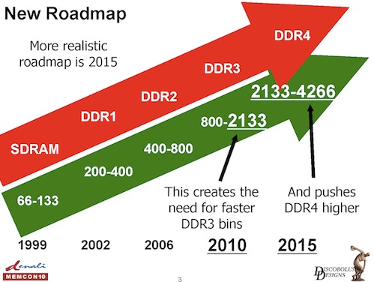
DDR Speeds

Slide 8
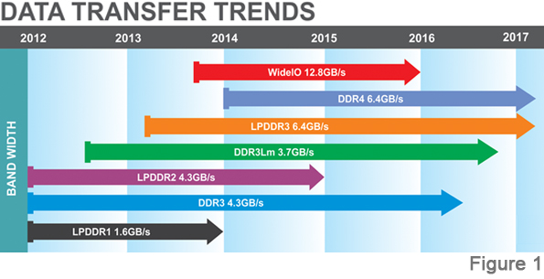
DDR Speeds (2)

Slide 9
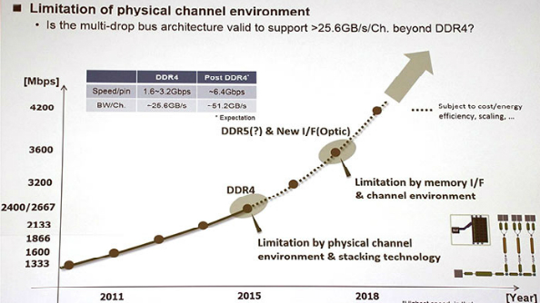
DDR 5

Slide 10
DDR5 (2)
DDR5 is coming soon. JEDEC says it will finalise the specs for DDR5 technology in 2018. DDR5 will succeed the current-gen DDR4 RAM, with twice the speed, more power efficiency, and double the density of DDR4.
With double the density, DDR5 will offer larger memory kits (32GB - 128GB, possibly) compared to now.
Most likely going into servers and high-end workstation/ gaming PCs at first, and then filtering down to other devices, and even appear in low-power form for laptops and mobile devices.
(http://www.tweaktown.com/news/.....)

Slide 11
Power Consumption Decrease
Central Processing Units have power consumption measured (or rated) by TDP (Thermal Design Power) in Watts.
High wattage makes for high heat at ‘real load’ usage of the CPU.

Slide 12
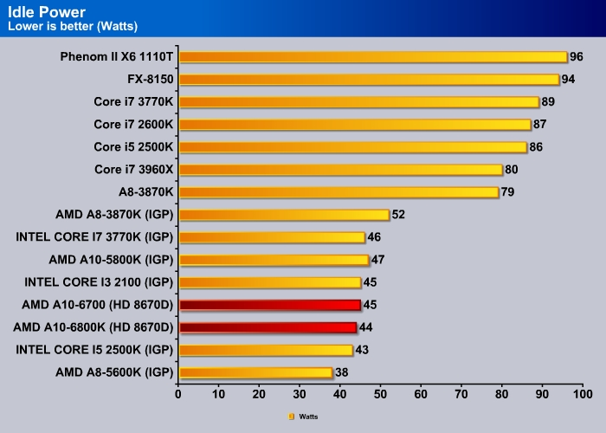
Power Consumption Decrease (2)
Also:
Intel Core M-5Y70 @ 1.10GHz – 688 watts
Intel Core i7-2670QM @ 2.20GHz - 133 watts

Slide 13
Multiple Cores
Quad core computers are commonplace now.
Why not ‘keep going’ – adding cores to a die, and reengineering the best parallel processing techniques?
Is this ‘Single-chip Cloud Computing’?
Or ‘On-Chip Networks’?

Slide 14
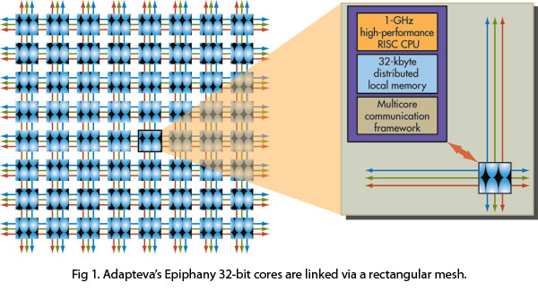
Multiple Cores (2)

Slide 15
Single-chip Cloud Computing
Single-chip Cloud Computing (SCC) is being developed by Intel, and they seem to have settled on 48 cores.
This is still quite experimental – objectified by the fact that it can only run on a (dedicated?) version of Linux, according to the most up-to-date information I could find.

Slide 16
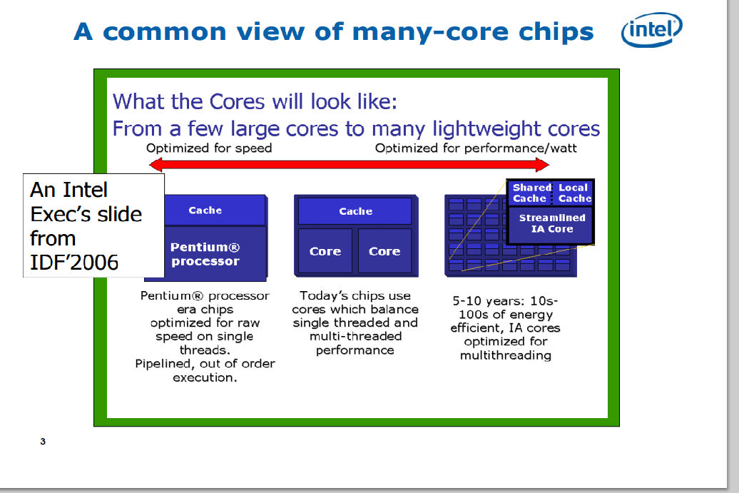
Single-chip Cloud Computing (2)

Slide 17
Single-chip Cloud Computing (3)
First Si (silicon (device)) with 48 iA (Intel Architecture) cores on a single die.
Power envelope 125W, Core @ 1GHz, Mesh @ 2GHz
Message passing architecture
No coherent shared memory
Proof of concept for scalable many-core solution
Next generation 2 D (2-dimension) mesh interconnect
Bisection B/W 1.5Tb/s to 2Tb/s, average power - 6W to 12 W (Watts)
Fine grain dynamic power management

Slide 18
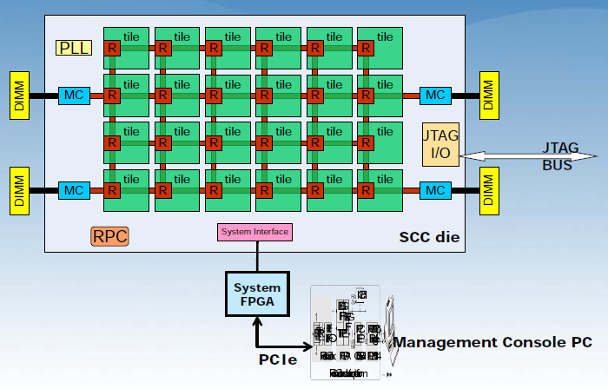
Single-chip Cloud Computing (4)

Slide 19
Single-chip Cloud Computing (4)
From Slide 15:
PLL – Phase-Locked Loop (circuit)
RPC – Remote Procedure Call
DIMM – Dual Inline Memory Module (RAM)
MC – Memory Controller
JTAG – Joint Test Action Group
FPGA – Field Programmable Gate Array (integrated circuit)

Slide 20
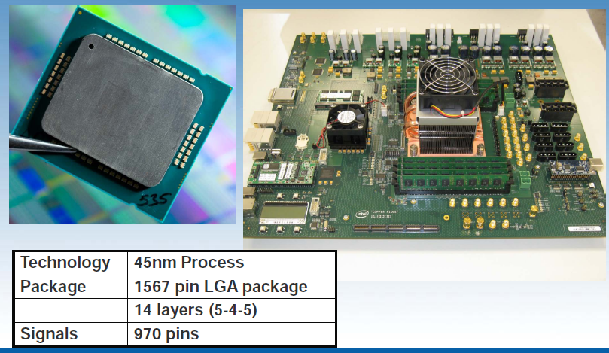
SCC Package and Test Board
Courtesy: intel

Slide 21
On-Chip Network
The trend in CPUs is towards ever-larger chip multiprocessors (CMPs).
The CMP overcomes diminishing returns of increasingly complex single-core processors
Communications are critical to the CMP’s performance -
between cores, cache banks, DRAM controllers ...
Delays in information can stall the pipeline

Slide 22
On-Chip Network (2)
BUT…
The ‘common bus’ does not scale beyond 8 cores:
electrical loading on the bus significantly reduces its speed.
The shared bus cannot support the bandwidth demand

Slide 23
The On-Chip Network (3)
Build a network, routing information between endpoints.
Increased bandwidth and scales with the number of cores.
CMP (3x3)
Network
Links
Core
+
Router

Slide 24
On-Chip Network (4)
On-chip networks (or NoC (Network on Chip)) have similar (or, at least, comparable) new architectures, where the scale of networking (in one architecture or another) is increasing:
Intel’s “Single-chip Cloud Computer”... 48 cores
Tilera Corperation TILE-Gx... 100 cores

Slide 25
On-Chip Network (5)
On-chip network questions and/or issues:
What should the topology be?
How should efficient routing be done?
What should the buffer size be?
Can Quality of Service guarantees be made in the network?
How do you handle congestion in the network?

Slide 26
Can We Apply Traditional Solutions?
On-chip networks have a very different set of constraints.
Three first-class considerations in processor design:
Chip area and space, power consumption, implied complexity
This impacts: integration (e.g., fitting more cores), cost, performance, thermal dissipation, design and verification...
The on-chip network has a unique design.
Likely to require novel solutions to traditional problems.
The networking community might contribute to design.

Slide 27
NoC Characteristics – What is Different?
Topology known, fixed, and regular
Links expensive, cannot over-provision
CMP (3x3)
Latency 2-4 cycles for
router and link
No Net Flow one-to-many cache access
Src
R
R
Coordination global is often
less expensive
Routing min. complexity,
low latency
Notes:
topology: known and fixed beyond the design stage, and regular for efficiency reasons
routing: routing is very minimal in complexity and low latency for maintaing efficient communication
links: are thin for area constraints, and for the same reason cannot be overprovisioned to handle temporal
bursts of traffic
net flow: with cache banks spread across all of the cores, a single core’s traffic pattern is one-to-many
latency: network latency is very low, only 1-2 cycles through the router, and 1-2 cycles over a link
coordination: while global coordination is not feasible in the Internet, global coordination is often less
expensive than distributed techniques on the chip

Slide 28
Future Work - Bufferless NoCs
The computer architecture community is now evaluating buffers:
30-40% of static and dynamic energy (e.g., Intel Tera-Scale)
75% of NoC area of research is in a TRIPS prototype (Tera-op, Reliable, Intelligently adaptive Processing System)
With a bufferless (BLESS) NoC design:
energy is reduced by ~40%, and area by ~60%
comparable throughput for low to moderate workloads
28
Notes:
As previously mentioned, the question of buffer size is currently hot in debate by the architecture community. this is also driven by the first-class design constraints of chip area and power. For example,

Slide 29
How Bufferless NoCs Work
Packet Creation: L1 miss, L1 service, write-back..
Injection: only when an output port is available
CMP
D
Routing: commonly X,Y-routing (first X-dir, then Y)
S1
0
1
2
Arbitration: oldest flit-first (dead/live-lock free)
1
Deflection: arbitration causing non-optimal hop
0
S2
Contending for top port, oldest first, newest deflected
Age is initialised

Slide 30
Thinking Hardware?
Artificial Intelligence (AI) is associated with software – systems software and applications.
For many years computer architects have been considering a means of moving away from the von Neumann architecture to a more dynamic hardware.

Slide 31
SyNAPSE
Defense Advanced Research Projects Agency (DARPA) to re-create the human brain's perception, cognitive, sensation, interaction, and action abilities.

Slide 32
SyNAPSE (2)
DARPA's Systems of Neuromorphic Adaptive Plastic Scalable Electronics (SyNAPSE) project:
to create a system that not only analyses complex information from multiple sensory modalities at once, but also dynamically rewires itself as it interacts with its environment

Slide 33
SyNAPSE (3)
Digital silicon circuits inspired by neurobiology to make up what is referred to as a 'neurosynaptic core' with integrated memory (replicated synapses), computation (replicated neurons), and communication (replicated axons).

Slide 34
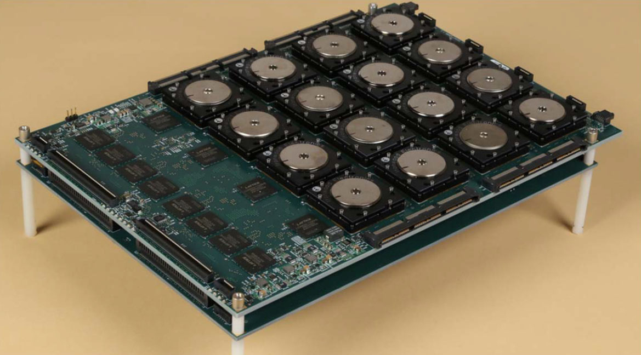
SyNAPSE Chips

Slide 35
Other Neural Chip Developments
As well as that SyNAPSE chip combination, there are other developments in neural-type processors:
IBM TrueNorth
Hewlett Packard Memristors

Slide 36
Brain-on-a-Chip
“A completely different – and revolutionary – human brain model has been designed by researchers in Japan who introduced the concept of a new class of computer which does not use any circuit or logic gate. This artificial brain-building project differs from all others in the world. It does not use logic-gate based computing within the framework of Turing. The decision-making protocol is not a logical reduction of decision, rather projection of frequency fractal operations in a real space, it is an engineering perspective of Gödel’s incompleteness theorem.”
(http://www.nanowerk.com/spotlight/spotid=35084.php)

Slide 37
New IBM Chip - TrueNorth
Research published in Journal Science
Consists of electronic “Neurons”
It attempts to mimic the way brain recognises patterns
Works parallely
Would be able to recognise that a person in a video is picking up an identifiable object or control a robot that is reaching into a pocket and pulling out a coin. (Humans can do this without any ‘conscious’ effort.)
5.4 billion transistors (only 70 milliwatts of power)
In contrast, an Intel processor has 1.4 billion processors and require 35 - 140 watts!!
One million neurons – about as complex as the brain of a bee

Slide 38
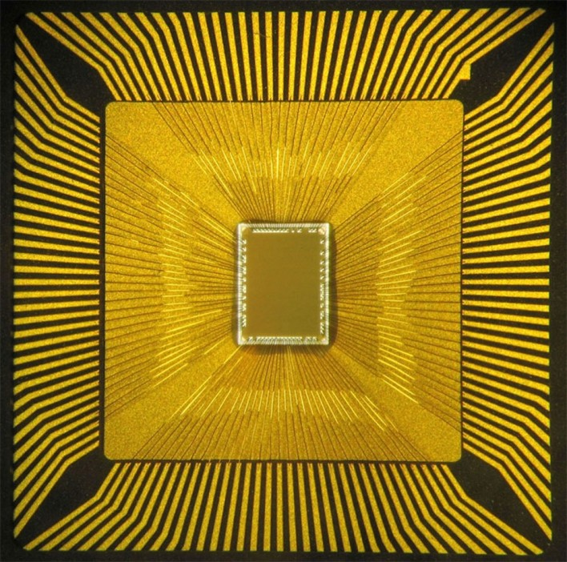
The TrueNorth Chip

Slide 39
TrueNorth (IBM) Brain Chip Architecture
A neurosynaptic supercomputer the size of a postage stamp that runs on the energy equivalent of a hearing-aid battery, this technology could transform science, technology, business, government, and society by enabling vision, audition, and multi-sensory applications.
(August 8, 2014: http://www.frogheart.ca/?p=14360)

Slide 40
TrueNorth
In a brain, each neuron is connected to thousands of others. Neurons send signals to each other using tiny electrical discharges called spikes. When a neuron receives the right number of spikes from other neurons at the right time, those incoming spikes make a pattern.
If the pattern matches one that the neuron has learnt through experience (such as a certain pattern), it will send out a spike of its own to the thousands of other neurons that it connects to. That spike will add to the patterns being seen by all those other neurons.

Slide 41
TrueNorth (2)
TrueNorth works exactly the same way as the brain. Instead of a small number of big CPUs, it has a huge number of small artificial neurons, all connected.
Normal computers can perform precision calculations with high speed, but brains can deal with imprecision and vague decisions in a constantly changing world. (Dynamically)

Slide 42
The Neurosynaptic Chip
IBM’s brain-inspired architecture consists of a network of neurosynaptic cores. Cores are distributed and operate in parallel. Cores operate—without a clock—in an event-driven fashion. Cores integrate memory, computation, and communication. Individual cores can fail and yet, like the brain, the architecture can still function. Cores on the same chip communicate with one another via an on-chip event-driven network. Chips communicate via an inter-chip interface leading to seamless availability like the cortex, enabling creation of scalable neuromorphic systems.
https://theinformationageblog.wordpress.com/2017/03/27/definition-series-neurosynaptic-chip/ (27th March 2017)

Slide 43
Hewlett Packard Memristors
Memristor is a portmanteau of the words memory and resistor.
Memristors themselves are passive, two terminal components with the ability to ‘remember’ the charge carried across themselves, even when there is no current or voltage present.

Slide 44
Memristor and Circuit Elements (Electrical Engineering)
Capacitor
Inductor
Resistor
Memory + Resistor = Memristor (1971), the fourth fundamental circuit element forming a non-linear relationship between electric charge and magnetic flux linkage
‘Remembers’ how much voltage is carried and for how long = memory and learning

Slide 45
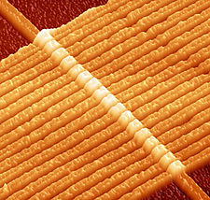
Structure
The device developed by HP Labs consists of a 50nm thin film of titanium dioxide with 5nm electrodes on either side. There are two layers to the film, one of which is oxygen depleted.

Slide 46
Function
The oxygen depleted spots act as charge carriers, and drift when an electric field is applied, changing the combined resistance of the two layers. The carriers can be moved back by introducing a reversed flow of charge, which causes the device to return to it's initial state.
The memristor will maintain its configuration even if the current is cut off, making it a more robust memory solution compared to the devices currently on the market.

Slide 47
Memristor Potential
The true potential of memristors lies in the fact that they are capable of having dozens, if not hundreds of different states, instead of just the two that we have come to associate with computing.
Memristors are also capable of performing logic functions, which means that the current compartmentalised structure of computing could have an alternative, as we create devices capable of both storing and processing data in the same space.

Slide 48
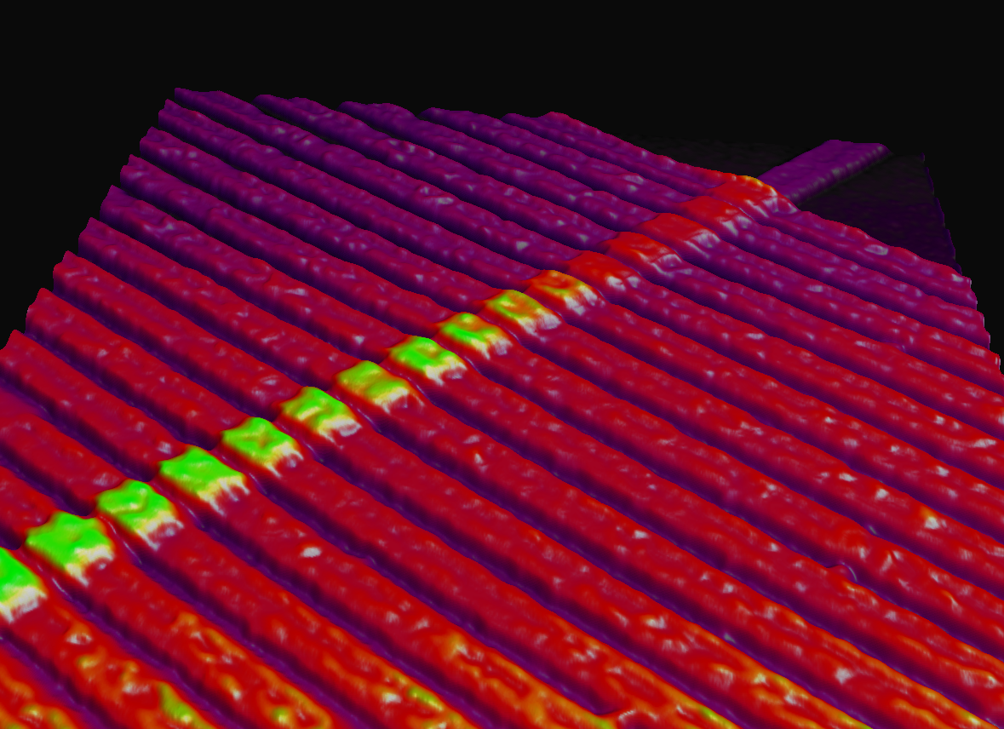
Neural Plasticity and the Memristor

Slide 49
Neural Plasticity and the Electrochemical Atomic Switch
A nanoscale device with a gap bridged by a copper filament under a voltage pulse stimulation will give a change in conductance which is time-dependant - a change in strength that is nearly identical to the one found in biological synaptic systems.
It mimics short-term and long-term memory.
It responds to the presence of air and temperature changes: it has the potential to perceive the environment much like the human brain.
(George Dvorsky, June 11, 2012 article for IO9)

Slide 50
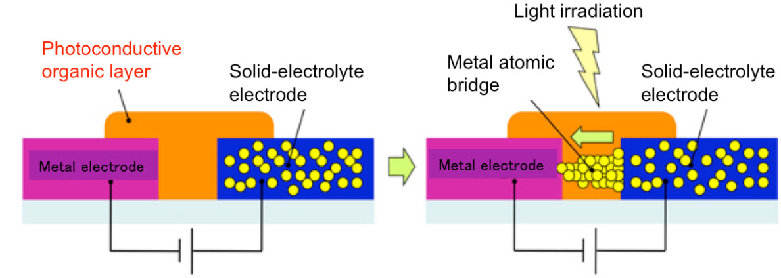
What is an Atomic Switch?

Slide 51
What is an Atomic Switch? (2)
The atomic switch, a nanoscale circuit element, has been shown to possess synapse-like properties in a purely inorganic device.
The device uses a billion junctions per square centimetre incorporated into a densely interconnected network of silver nanowires.

Slide 52
What is an Atomic Switch? (3)
Like biological neural networks, these atomic switch networks (ASN) generate memristor-like emergent behaviours comprised of their distributed, collective interactions.
These emergent behaviours are a principal characteristic of biological neural networks and many other complex systems. Ongoing studies involve the use of these emergent behaviours for information processing, aimed toward developing a new class of cognitive technology.

Slide 53
Memristor Footnote
‘The Register’ (online newsletter on technology) reports (28 June 2016) that memristors research is slowing down, due to or to coincide with the retirement of Hewlett Packard Enterprise’s chief executive, Martin Fink. The paper suggests that it could continue if Samsung or a similar company, were to buy it and continue.
… just sayin’…

Slide 54
2017 Motherboards
What are motherboards looking like – what will they look like in the future?
Future motherboard architecture is VERY hard to find (on the Web or in scientific papers).
Intel released a ‘Kabylake’ processor (around August 2016) This seems to be the current high-spec CPU, and the range is to include a ‘10nm Cannon Lake’ processor this year, and it needs a motherboard.

Slide 55
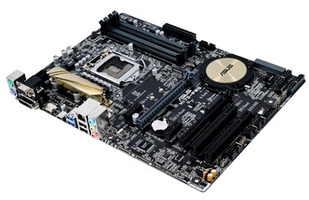
2017 Motherboards (2)
I went looking for an image of an Intel Cannonlake motherboard – for about an HOUR. This is the closest I could find.

Slide 56
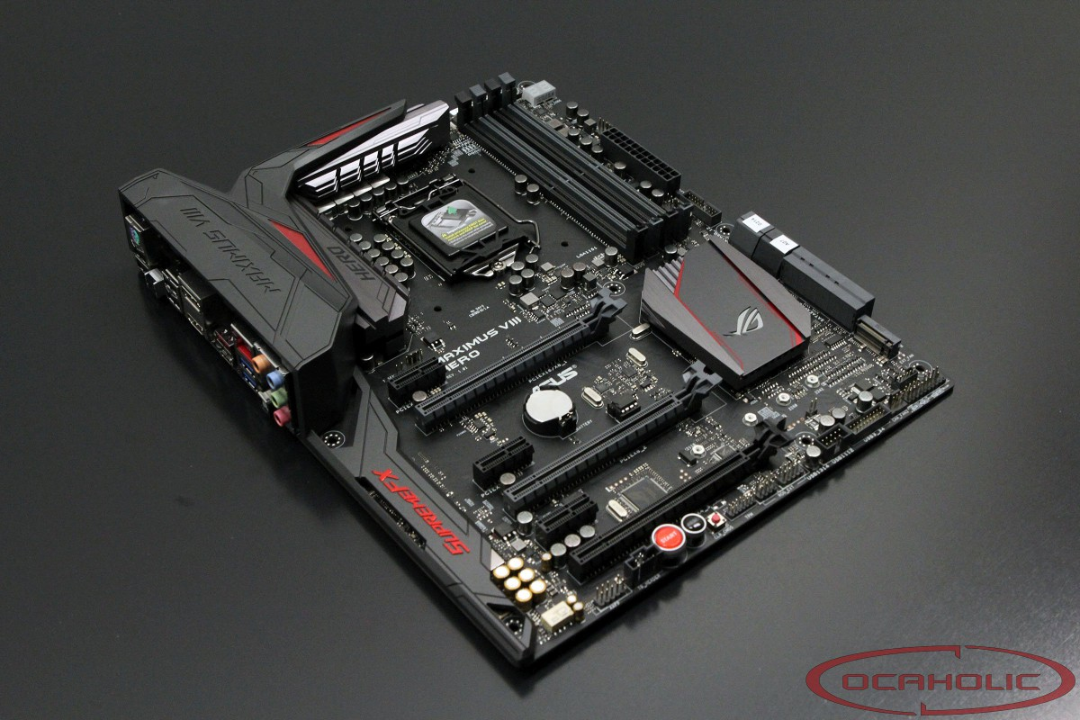
2017 Motherboards (3)
Asus maximus VIII Hero motherboard

Slide 57
2017 Motherboards (4)
The general appearance of motherboards shows that there is not a lot of obvious change in their design and architecture from year to year.
Often the basic architecture design remains the same – the changes are in terms of improvements in power usage and communication reliability.

Slide 58
Next…
Next time...
…REVISION OF NOTES from Weeks 2 - 11

